Slide 1

KALYANI GOVERNMENT ENGINEERING COLLEGE
PROJECT REPORT ON
Automatic Door Opener using Arduino and PIR Sensor
Guided by : SUBHASHIS MAITRA
PRESENTED BY… SUMIT MAITY
ece -3rd year

Slide 2
INTRODUCTION
An automatic door opener system is a simple project based on PIR sensor and Arduino, which automatically opens and closes the door by detecting a person or object.
So, in order to understand the potential of this concept, we have implemented a simple automatic door opener system using Arduino and PIR sensor.

Slide 3
BLOCK DIAGRAM
POWER SUPPLY
ARDUINO UNO
PIR SENSOR
L298N MOTOR DRIVER MODULE
DC MOTOR
DOOR
GEAR ARRANGEMENT

Slide 4
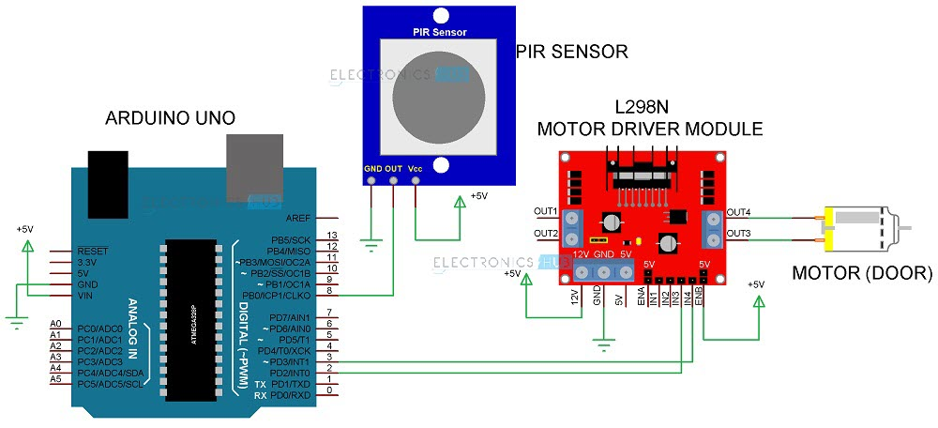
CIRCUIT DIAGRAM

Slide 5
WORKING PRINCIPLE
The working of the automatic door opener system using Arduino and PIR sensor is very simple.
When the PIR sensor detects any motion of a person, its data out pin will become high. As this pin is connected to the Arduino, it will detect this HIGH signal and understands that there is person approaching the door.
Arduino then immediately activates the L298N motor driver module to open the door. After some time (about 2 to 5 seconds), the arduino will once again activate the motor driver to close the door.

Slide 6
COMPONENTS REQUIRED
SL. No. | COMPONENTS | SPECIFICATION | QUANTITY
1 | Arduino | Uno | 1
2 | PIR Sensor |  | 1
3 | Motor Driver | L298N | 1
4 | DC Motor | 5v | 1
5 | Bread Board | 17x5 cm² | 1
6 | Connecting Wires | Jumpers | 10
7 | Power Supply | 5v | 1

Slide 7
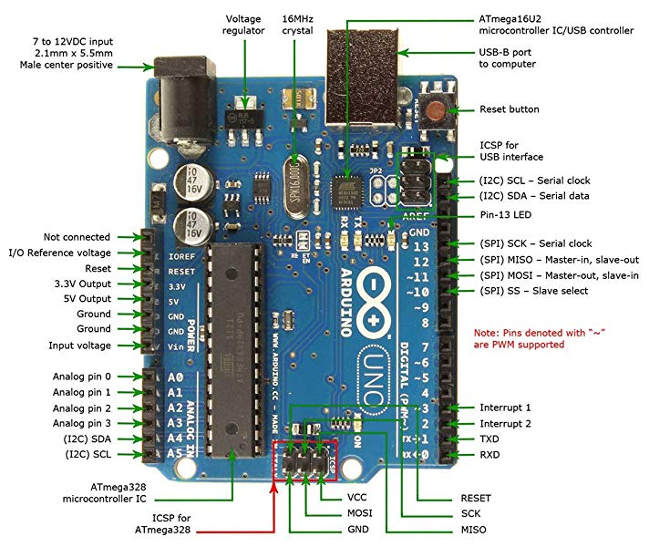
Arduino UNO
In this project, Arduino UNO acts as the main controlling part. It reads the data from the PIR Sensor and activates the L298N Motor Driver based on the data from the PIR Sensor.

Slide 8
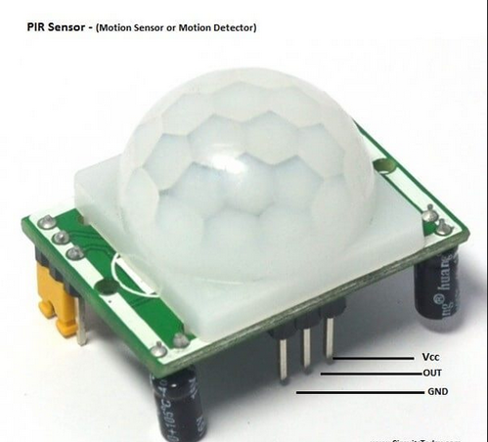
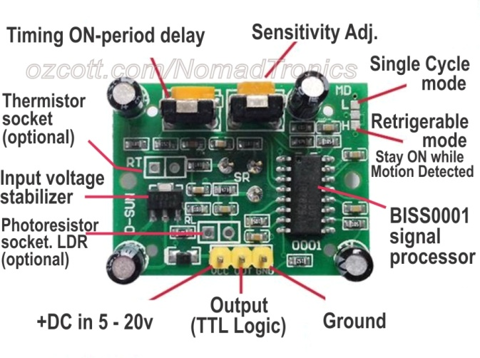
PIR sensor

Slide 9
PIR sensor
PIN NUMBER | PIN NAME | DESCRIPTION
1 | Vcc | Input voltage is +5V for typical applications. Can range from 4.5V- 12V
2 | High/Low Output | Digital pulse high (3.3V) when triggered (motion detected) digital low(0V) when idle(no motion detected
3 | Gnd | Connected to ground of circuit

Slide 10
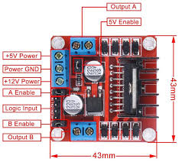
L298N Motor Driver Module
Motor Driver is an important part of the project as it is responsible for driving the motor of the door (CD Tray Motor in this case). In this project, we have used the very common and very popular L298N Motor Driver Module.
• Input Voltage: 3.2V~40Vdc. Brief Data:
• Driver: L298N Dual H Bridge DC Motor Driver
• Power Supply: DC 5 V - 35 V
• Peak current: 2 Amp
• Operating current range: 0 ~ 36mA
• Maximum power consumption: 20W (when the temperature T = 75 ℃).
• On-board +5V regulated Output supply.

Slide 11
code

Slide 12
Application
ARDUINO BASED AUTOMATIC DOOR OPENER SYSTEM IS A VERY USEFUL PROJECT AS IT ENABLE US TO UNDERSTAND THE CONCEPT OF SUCH AUTOMATIC DOOR OPENER SYSTEMS AND HOW THEY WORK.
THESE SYSTEMS ARE ALREADY BEING USED IN MANY PLACES LIKE MALLS, THEATERS AND HOSPITALS.
WE CAN IMPLEMENT THESE AT OUR HOME IN GARAGE DOOR OPENERS, TOILET COVER OPENERS, OFFICE DOOR ETC.

Slide 13
FUTURE SCOPE
Along with this project we can use Face-detection through Camera for Automated Attendance System.
A better sensor is recommended to achieve new functionality. For instance, a suitable sensor such as radar sensor that could detect contraband good in any vehicle.

Slide 14
CONCLUSION
Further this can be enhanced interfacing a counting arrangement for keeping of entry and exit of people at particular place.
This can be achieved by interfacing the system with an EEPROM (non-volatile memory) to avoid loss of stored data even if the power fails.
Movement Sensed Automatic Door Operating System is very useful.

Slide 15
THANK YOU

